Slide 1
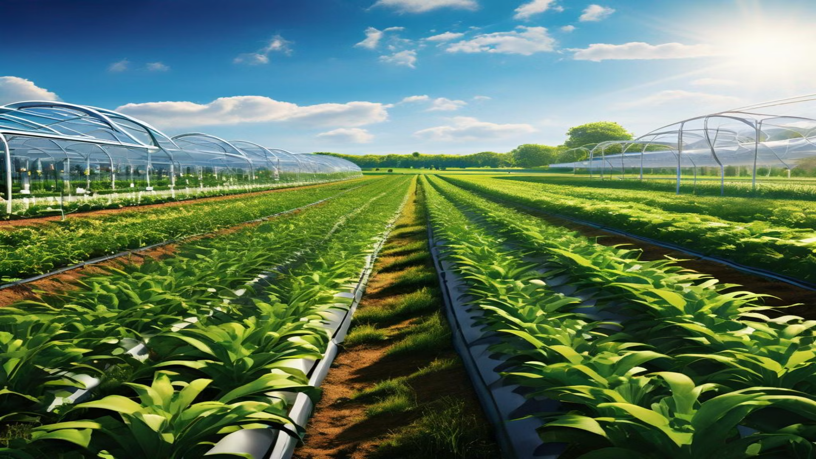
Farm Advice
Optimizing Irrigation for Modern Agriculture

Slide 2
Problem Statement:
Farmers face significant challenges in optimizing their irrigation practices. Water scarcity, unpredictable weather patterns, and inefficient irrigation systems lead to wasted resources, decreased crop yields, and potential damage to crops. According to the USDA, inefficient irrigation practices account for a staggering 50% of agricultural water waste.

Slide 3
Solution:
Introducing Farm Advice, an AI-powered irrigation management system designed to revolutionize water usage in agriculture. Farm Advice provides personalized irrigation schedules, proactive weather-based insights, and intelligent chatbot support, empowering farmers to optimize water usage, improve crop yields, and achieve sustainable farming practices.

Slide 4
Market Opportunity:
The global irrigation market is booming, projected to reach $23.5 billion by 2027. This growth is fueled by increasing demand for food production, coupled with concerns about water scarcity and climate change. Farm Advice addresses these key challenges, positioning itself for significant market share.
Competitors:
Existing irrigation solutions often rely on manual adjustments or basic sensor systems. Farm Advice stands apart by leveraging advanced AI and data analytics to provide a more personalized and proactive approach to irrigation management.

Slide 5
Why Us?
AI-powered analytics: Farm Advice's unique AI algorithms analyze data from sensors, weather forecasts, and crop models to create personalized irrigation schedules and predict potential disruptions.
Proactive weather insights: The system integrates weather APIs, providing two-day forecasts and enabling farmers to adapt their irrigation plans to changing conditions.
Intelligent chatbot support: Our AI-powered chatbot offers 24/7 support, answering questions, diagnosing crop problems, and recommending solutions, ensuring farmers have the information they need when they need it.

Slide 6
Business Model:
Farm Advice offers a subscription-based model, with different tiers based on farm size and features. We also generate revenue through partnerships with agricultural equipment manufacturers and consulting services.

Slide 7
Funding Needed:
We are seeking $3000 in funding to further develop our platform, expand our marketing efforts, and accelerate our growth strategy. These funds will enable us to:
Enhance our AI capabilities and data analytics => $1800
Develop new features and integrations => $700
Expand our user base and secure key partnerships => $200
Build a strong marketing and sales team => $300

Slide 8
Call to Action:
Farm Advice offers a transformative solution for modern agriculture. We believe that by optimizing irrigation practices, we can empower farmers to achieve higher yields, reduce water waste, and create a more sustainable future. Join us in revolutionizing agriculture – contact us today to schedule a meeting and learn more about our vision.

